Slide 1

EMPLOYEE
SALARIES

Slide 2
Project Members
Abdul Tawab “Project Admin” Jahanzeb
Shadmer
Merwais
Ebadullah
Mohammad Bashir

Slide 3
Project Outline
The task is to build a salary management system for an organization.
Current salary system is manual therefore we wants to switch the system from manual
to automatic computerized salary management system.
The System we are going to develop is according to the user requirements which will perform salary calculation as well as tax calculation Moreover,
the system will be user friendly and ﬂexible enough.

Slide 4
Project Goals
The system should be capable of performing following functions:
Store basic information of employees of the organization.
Store salary information of employees (entered by the Editor ) such as, working hours, salary per hour, salary before tax, tax
Percentage, salary after tax, social security fee and etc.

Slide 5
Methodology
The most suitable and appropriate software development methodology we
found for our software development is waterfall software development model,
which gave us a clear view about our software and helped us to achieve our goal.

Slide 6
System requirements
Requirement analysis is an important phase of the system development cycle.
which provides us all the speciﬁcation of system in detail which are very essential to build the system and also provides us knowledge about the behavior of the system.
Functional Requirements
Non Functional Requirements

Slide 7
Functional Requirements
Functional Requirements of our system speciﬁcally deﬁnes functionalities of the system and behavior of the system. Functions that describe the behavior of the system will be
shown in the form of use cases.
Security for system which User authentication is required.
Adding : Our system will provide easier way to store salaries and info of every employee

Slide 8
Functional Requirements
Editing : our system will have the functionality to
provide edition in the information and salary
system of employee
Deletion : we will provide deletion functionality to
delete any employee which is no more in that
department
Searching: - to search out tax ﬁles, salary
Slip and more.

Slide 9
Non-functional Requirements
Performance
Performance of system should be adequate and fast.
User Friendly Environment
System interface should be simpleand user friendly.
Application Scalability
System should be ﬂexible and expendable for future use.
Platform Independence
System should be capable to work in any environment.

Slide 10
System Use case
In this section we will discuss the use case of salary management system. Uses cases show how the users interact with the system. There are three actors in our system, Editor, Organization managers and administrator. Each onehas its own responsibilities and level of access to the system.

Slide 11
Editor
Editor is responsible to maintain basic information of his organization members such as name, address, date of birth, joining date, social security number etc.
An Editor will be assigned a login and password for the system. After authentication he/she will be the only person authorized to add and edit the basic information of the employees . He/she will be able to calculate the salaries of the particular employees on the basis of given parameters.

Slide 12
Organization Manager
Organization manager is the main actor in our system. After passing through the authentication process he will have the access to the system and he is authorized to do the following actions.
Addition of necessary information,updates
Veriﬁcation of employee data and salary calculation
To calculate taxes payable by employees

Slide 13
System Administrator
The last actor is system administrator. His major responsibility is Maintenance .He checks the security logs, handles the security issues checks application errors ,handles the error massages of the application.

Slide 14
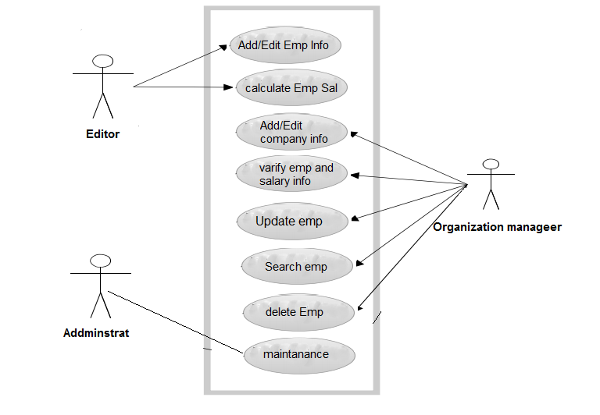
Use case Diagram

Slide 15
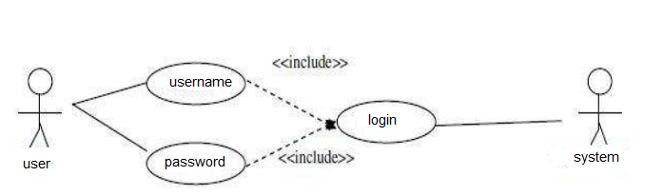
Use Case Diagram of Login
Scenario
Actors (Organization manager, Editor) want to enter into the system to perform the speciﬁc operations.
Basic Flow
When any of the actors want to log-in, the system will ask the user name and password. On entering the log-in parameters the system will authenticate them. After validation it will authorized the actor to enter.

Slide 16
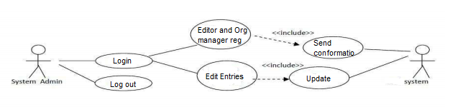
Use Case Scenario of Registration
Scenario
Registration is required to enter and use the system. After logged-in the
administrator is authorized only to register the actors (organization manager
and Editor) into the system or edit their accounts.

Slide 17
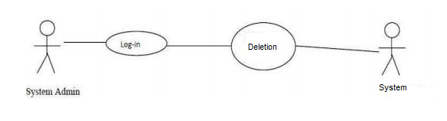
Use case and Scenario for Deletion of users
Scenario
Administrator wants to delete the existing user accounts.
Basic Flow
Administrator can delete the existing user accounts after logging in whenever it is necessary.
Alternative Flow
System will generate a message to conﬁrm deletion of existing user account or give an
alternative to cancel the process without deletion.
Pre-Condition
User account must exist.
Post-Condition
System will delete user account and update.

Slide 18
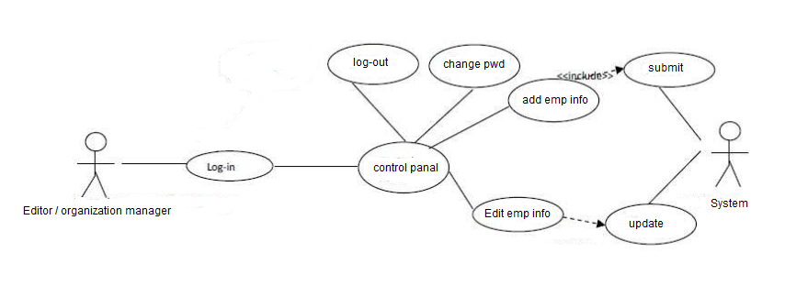
Add and Edit Use Case and Scenario of Employee
Scenario
After logging in the actors enter into control panel from where they can perform the following functions :
• Log-out directly from the system
• Change of password
• Add information of a
new employee
• Edit information of the
existing employee

Slide 19
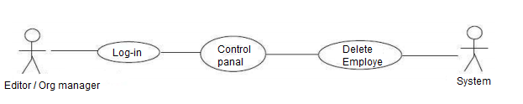
Use Case for Deletion of Employee Accounts

Slide 20
Use Case for Deletion of Employee Accounts
Scenario
In case, if an employee temporarily or permanently quites from
the job or rejoins, then the authorized users will change his status
in the system.
Basic Flow
After logging-in, the user will search for the employee by
his ID and performing the following functions :
• The user will activate the account, if the employee wants to rejoin the
organization after some time or change his location.
• In-Activate the account if employee wants to quite temporarily.
• Delete the employee account if an employee quites permanently.

Slide 21
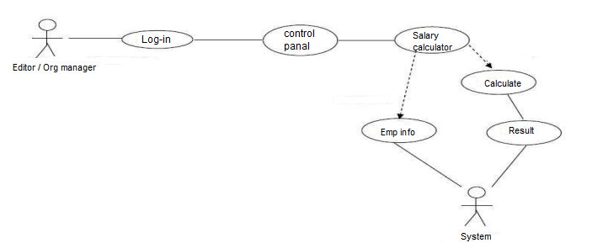
Use case for Salary Calculation

Slide 22
Use case for Salary Calculation
Scenario
User wants to calculate the salary of an employee.
Basic Flow
After logged-in to system the user will select salary calculator from control panel to calculate the salary of an employee. In salary calculator the user will enter the ID of an employee. A procedure calls in response and gathers the required information about the user, adding it to the salary calculator.

Slide 23
Use case for Salary Calculation
User will enter the following ﬁelds:
In case of hourly based salary, enters hours worked per day.
In case of ﬁxed salary per month ,enters it.
Percentage of tax.
Percentage of social security.
following calculation will be performed:
Salary of an employee will be calculated.
Tax of an employee will be calculated.
The results of an employee will be stored.

Slide 24
????? Any Questions ?????

